Slide 1
Tracking Women’s Political Empowerment
And Suffrage (1900-2000)
Athena B. Rodrigues
Data Science Department
Undergraduate Capstone Spring 2024

Slide 2
Research Questions
Can women’s political empowerment be categorized and reflect the changes in nation-state building, modernization, and gender equality over the 20th Century?
What trends emerge from the mapping of these categories and how do changes in women’s suffrage influence these categorizations?
Does this mapping method showcase any regional patterns in women's political empowerment or suffrage?
1
2
3

Slide 3
Data Variables
Geographic
WPEI
Year
Nation Name, Abbreviation, Unique ID Number, Continent
Index Number
between 0 and 1
1900 to 2000
Timeframe
Civil
Liberties
Civil
Society
Political Participation
Category
Voting
Change Points
Created Empowerment Category and Corresponding Number Value
Suffrage Determined through
0 (no suffrage) or 1 (suffrage)
Determines whether a change in empowerment or in voting has occurred between the previous year

Slide 4
Women’s Political Empowerment Index
Measures overall political empowerment over 100 years (1900-2012)
Contains three sub-indices for over 170 countries
Provides the most comprehensive and best-covering measure of empowerment
Takes into account newly formed countries, shifting central concepts of women’s rights, and a better representation of the Global South

Slide 5
Three Sub-Indices
Civil
Liberties
Civil
Society
Political
Participation
Freedom of domestic movement
Freedom from forced labor
Property rights
Access to justice
Freedom of discussion
Participation in Civil Service Organizations
Percentage of female journalists
Power distribution by gender
Political position representation
Presence of women in legislature

Slide 6
Empowerment Categories
Category | Range
Nascent | WPEI ≤ 0.188
Emerging | 0.188 ≤ WPEI ≤ 0.336
Developing | 0.335 ≤ WPEI ≤ 0.546
Established | WPEI ≥ 0.546

Slide 7
Empowerment Categories over the Decades

Slide 8
Correlation between Indicators by Category
Category | Civil Society and Civil Liberties | Civil Society and Political Participation | Civil Liberties and Political Participation
Nascent | -0.07942348 | 0.05531654 | -0.1336073*
Emerging | -0.22664845 | -0.10028010 | -0.6189087*
Developing | -0.07360711 | -0.09743562 | -0.6376153*
Established | 0.43980447* | 0.34631430* | -0.1018835

Slide 9
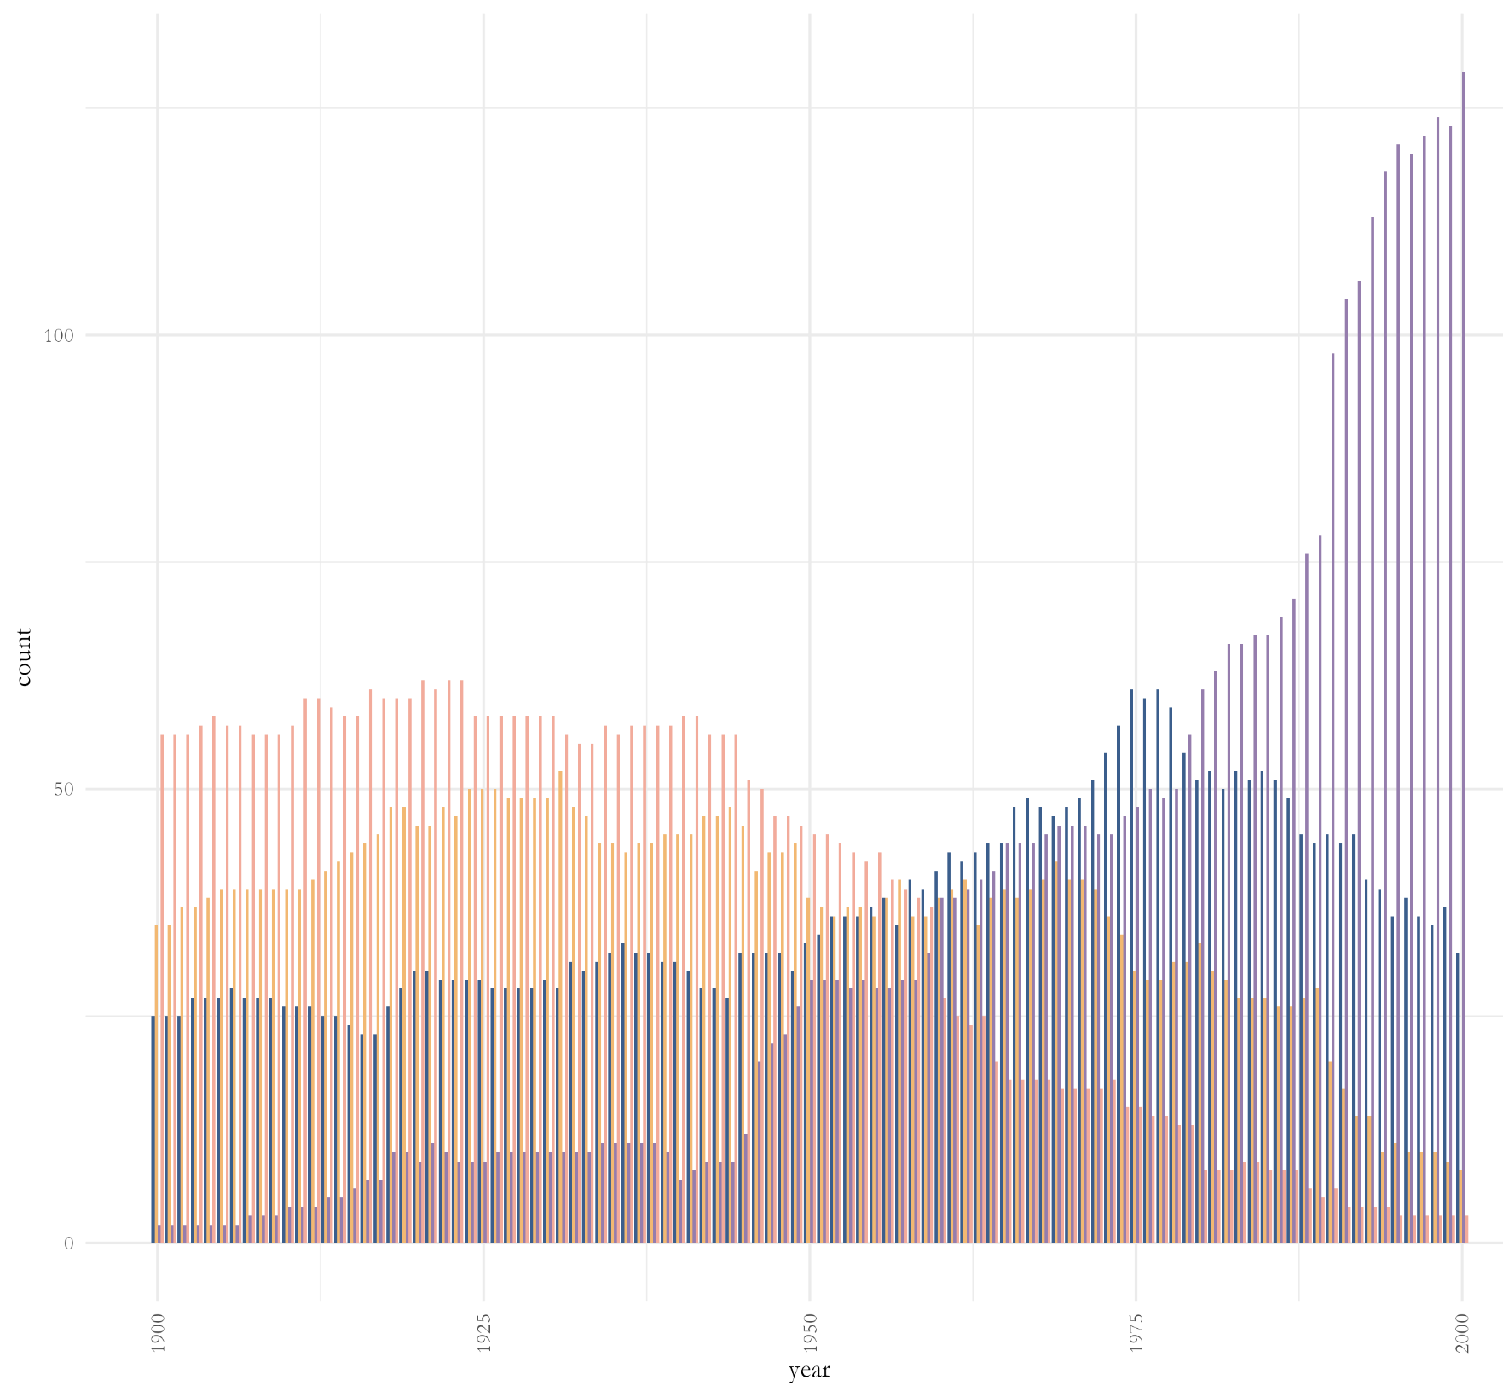
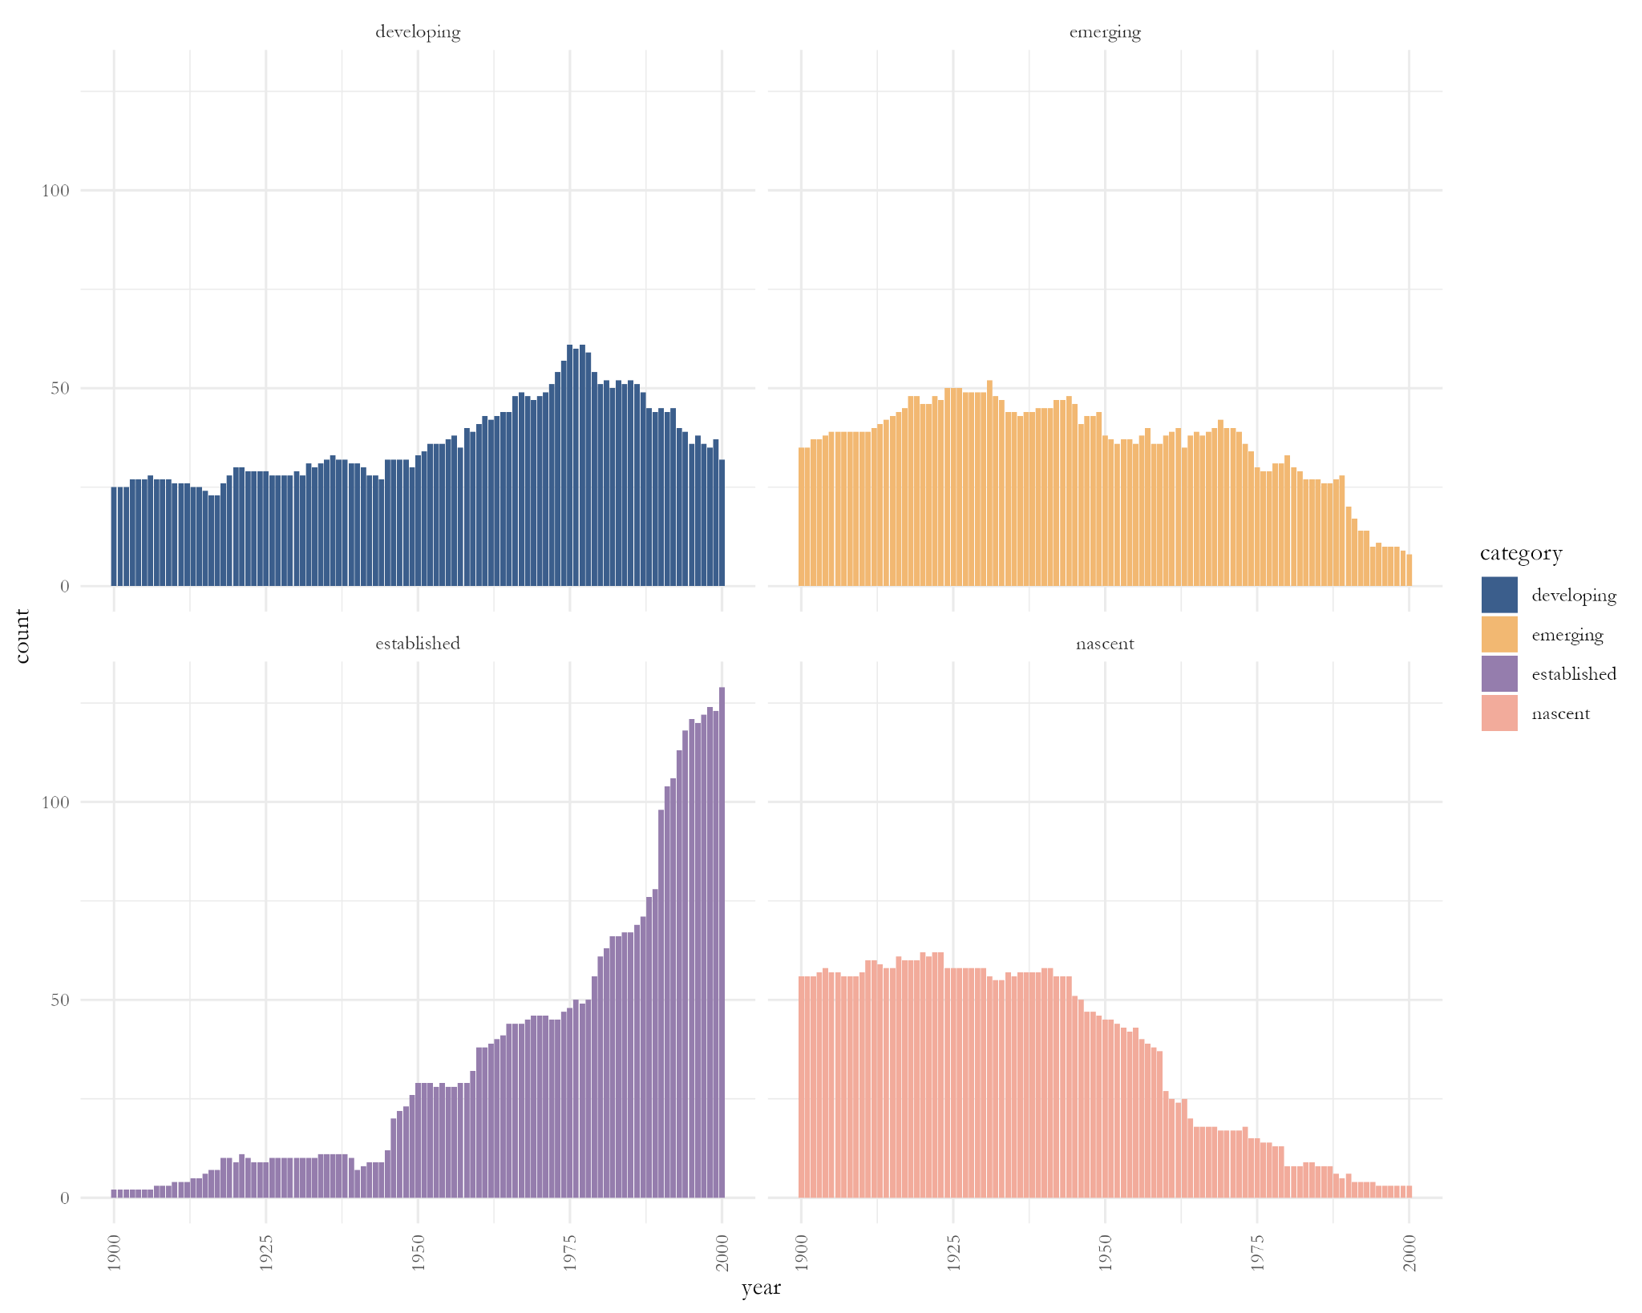
Empowerment Periods Graph

Slide 10
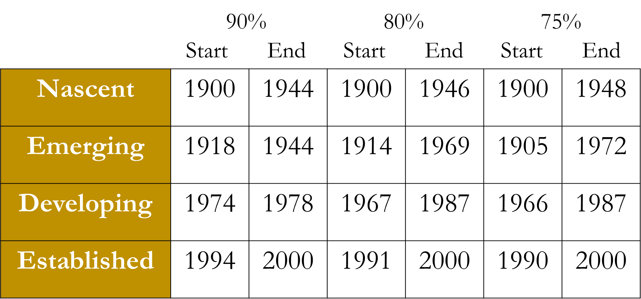
Empowerment Periods Thresholds

Slide 11
Empowerment Periods
Period | Years
Nascent | 1900 – 1955
Developing | 1956 – 1978
Established | 1979 - 2000

Slide 12
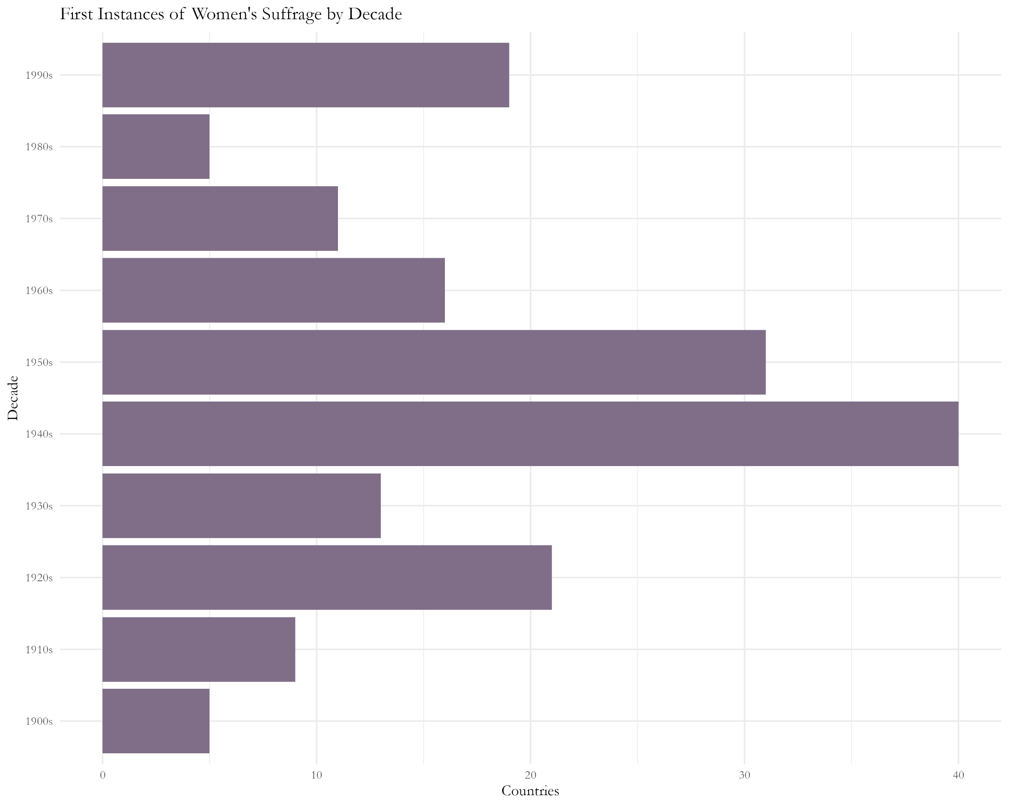
Suffrage over the Decades

Slide 13
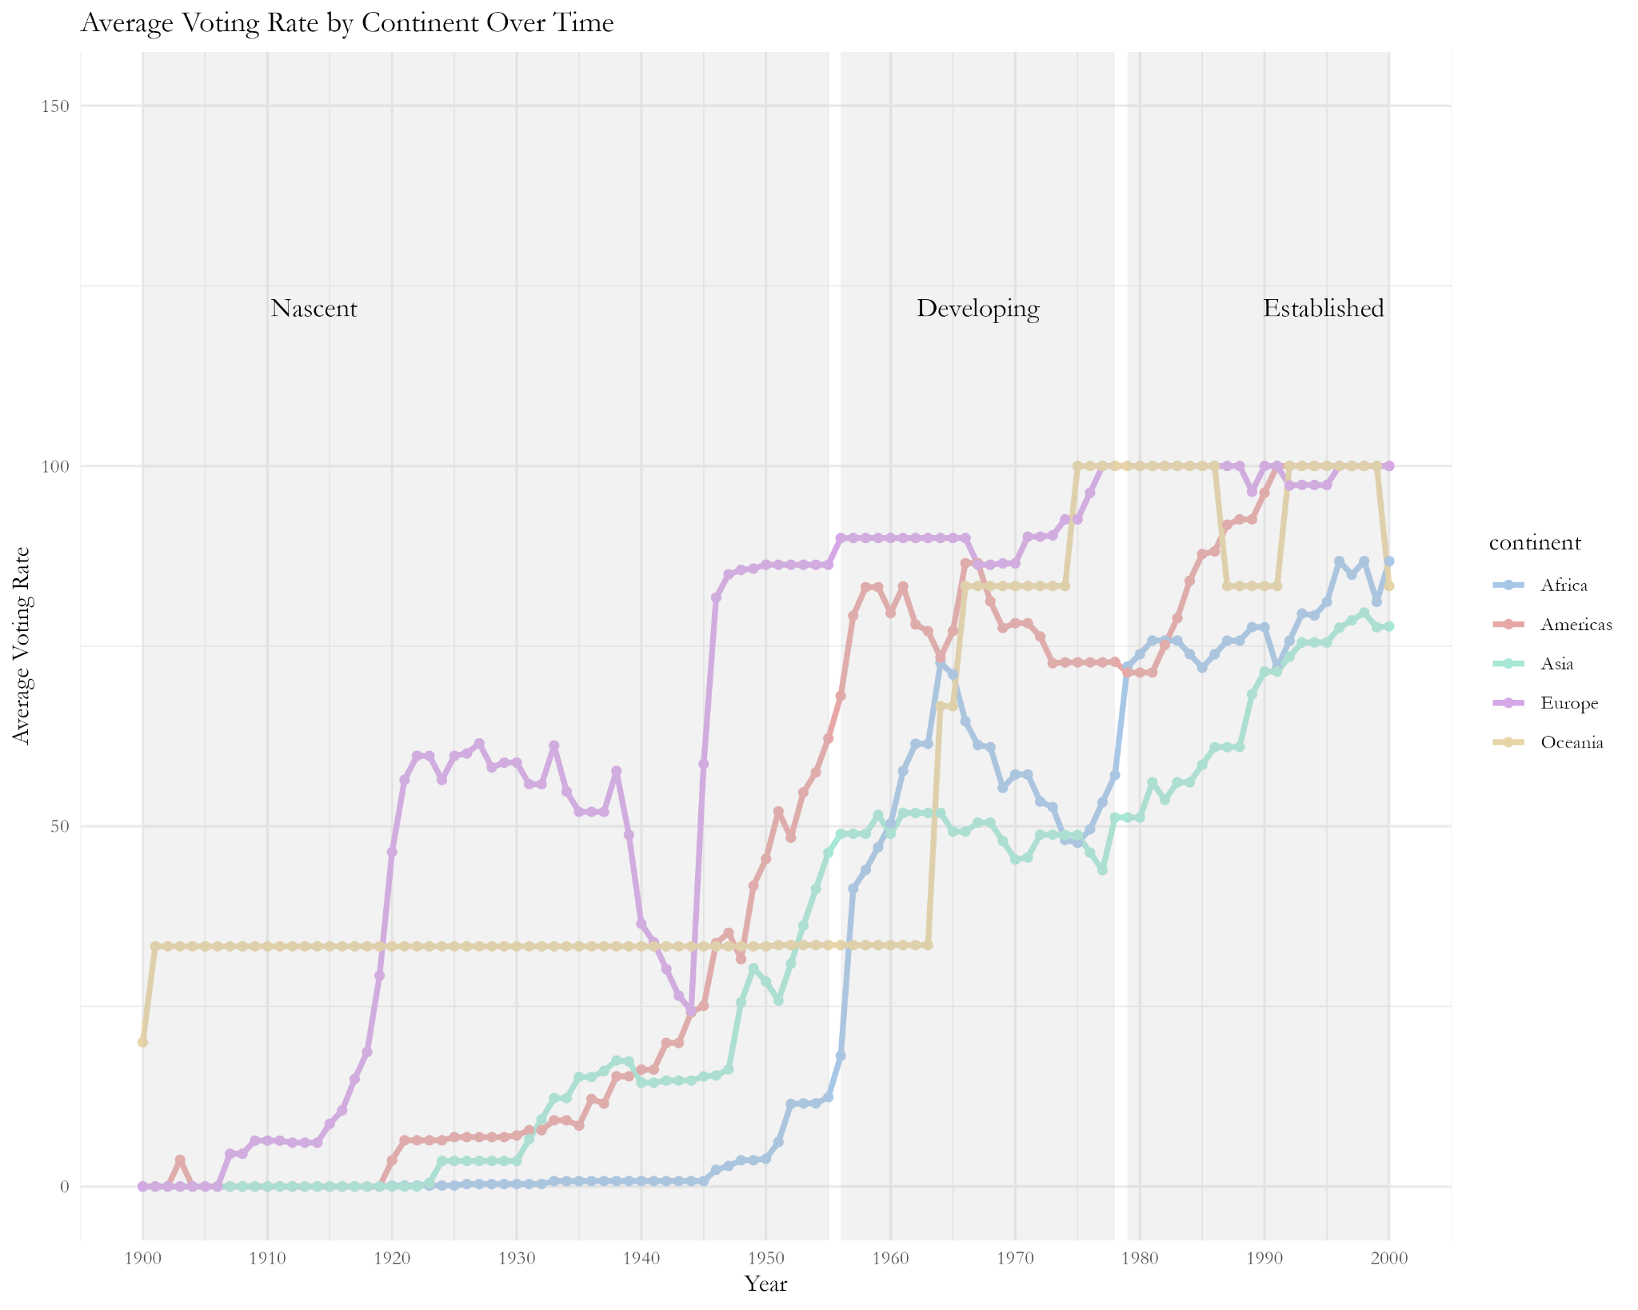
Suffrage by Continent

Slide 14
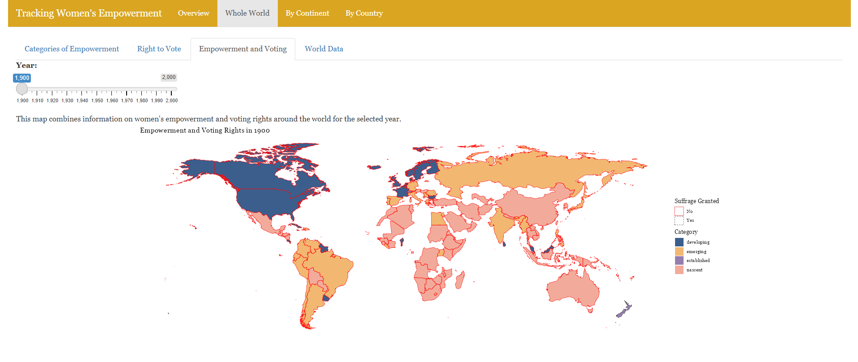
The Dashboard

Slide 15
Further Research Topics
Pre-World War versus Post-World War
Before Decolonization versus After DeColonization
Global North versus Global South
Impact of Historic Events in Women’s History

Slide 16
References
Sundström, A., Paxton, P., Wang, Y. T., & Lindberg, S. I. (2017). Women&#39;s political empowerment: A new global index, 1900–2012. World Development, 94, 321-335.
Coppedge, Michael, John Gerring, Carl Henrik Knutsen, Staffan I. Lindberg, Jan Teorell, David Altman, Fabio Angiolillo, Michael Bernhard, Cecilia Borella, Agnes Cornell, M. Steven Fish, Linnea Fox, Lisa Gastaldi, Haakon Gjerlow, Adam Glynn, Ana Good God, Sandra Grahn, Allen Hicken, Katrin Kinzelbach, Joshua Krusell, Kyle L. Marquardt, Kelly McMann, Valeriya Mechkova, Juraj Medzihorsky, Natalia Natsika, Anja Neundorf, Pamela Paxton, Daniel Pemstein, Josefine Pernes, Oskar Rydén, Johannes von Römer, Brigitte Seim, Rachel Sigman, Svend-Erik Skaaning, Jeffrey Staton, Aksel Sundström, Eitan Tzelgov, Yi-ting Wang, Tore Wig, Steven Wilson and Daniel Ziblatt. 2024. ”V-Dem [Country-Year/Country-Date] Dataset v14” Varieties of Democracy (V-Dem) Project. https://doi.org/10.23696/mcwt-fr58.
Pemstein, Daniel, Kyle L. Marquardt, Eitan Tzelgov, Yi-ting Wang, Juraj Medzihorsky, Joshua Krusell, Farhad Miri, and Johannes von Römer. 2024. “The V-Dem Measurement Model: Latent Variable Analysis for Cross-National and Cross-Temporal Expert-Coded Data”. V-Dem Working Paper No. 21. 9th edition. University of Gothenburg: Varieties of Democracy Institute.

